Slide 1
Unit -5
P.RAJESH
EMAIL: patnamrajeshrai@gmail.com

Slide 2
Overview
Wireless sensor networks
Applications
Network topology
Localization
Time synchronization
Energy efficient MAC protocols
Energy efficient and robust routing
Data centric routing

Slide 3
1. Introduction
Wireless sensor networks provide bridges between the virtual world of information technology and the real physical world.
They represent a fundamental paradigm shift from traditional inter human personal communications to autonomous inter-device communications.
Reasons : While the notion of networking distributed sensors and their use in military and industrial applications dates back at least to the 1970s, the early systems were primarily wired and small in scale.
It was only in the 1990s – when wireless technologies and low-power VLSI design became feasible
Perhaps one of the earliest research efforts in this direction was the low power wireless integrated micro sensors (LWIM) project at UCLA funded by DARPA .
The LWIM project focused on developing devices with low-power electronics in order to enable large, dense wireless sensor networks.

Slide 4
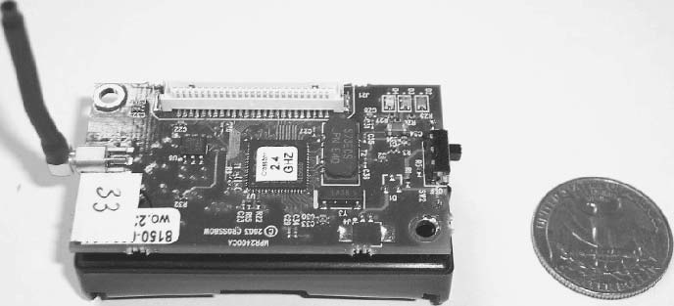
This project was succeeded by the Wireless Integrated Networked Sensors (WINS) project a few years later, in which researchers at UCLA collaborated with Rockwell Science Center to develop some of the first wireless sensor devices. Researchers at Berkeley developed embedded wireless sensor networking devices called motes, which were made publicly available commercially, along with TinyOS, an associated embedded operating system that facilitates the use of these devices

Slide 5
• 1970’s: Wired sensors connected to central location
• 1980’s: Distributed wired sensor networks
• 1993: LWIM project at UCLA
• 1999-2003: DARPA SensIT project: UC Berkeley, USC, Cornell etc.
• 2001: Intel Research Lab at Berkeley focused on WSN
• 2002: NSF Center for Embedded Networked Sensing
• 2001-2002: Emergence of sensor networks industry; startup companies including Sensoria, Crossbow, Ember Corp, SensiCast plus established ones: Intel, Bosch, Motorola, General Electric, Samsung.
• 2003-2004: IEEE 802.15.4 standard, Zigbee Alliance

Slide 6
1.1.networked wireless sensor devices
Low-power embedded processor: The computational tasks on a WSN device include the processing of both locally sensed information as well as information communicated by other sensors.
Sensors
memory
GPS
Processor
Radio source
Power source

Slide 7
Memory/storage:
i) Storage in the form of random access and read-only memory includes both program memory (from which instructions are executed by the processor).
ii) data memory (for storing raw and processed sensor measurements and other local information).
Radio transceiver: WSN devices include a low-rate, short-range wireless radio (10–100 kbps, <100 m). While currently quite limited in capability too, these radios are likely to improve in sophistication over time – including improvements in cost, spectral efficiency, tunability, and immunity to noise, fading, and interference.
Sensors: Due to bandwidth and power constraints, WSN devices primarily support only low-data-rate sensing. Many applications call for multi-modal sensing, so each device may have several sensors on board.
To specific sensors used are highly dependent on the application;
example:- they may include temperature sensors, light sensors, humidity sensors, pressure sensors, accelerometers, magnetometers, chemical sensors, acoustic sensors, or even low-resolution imagers.

Slide 8
Geopositioning system: In many WSN applications, it is important for all sensor measurements to be location stamped. The simplest way to obtain positioning is to pre-configure sensor locations at deployment, but this may only be feasible in limited deployments.
Particularly for outdoor operations, when the network is deployed in an ad hoc manner, such information is most easily obtained via satellite-based GPS.
In this case, other nodes must obtain their locations indirectly through network localization algorithms.
6. Power source: For flexible deployment the WSN device is likely to be battery powered (e.g. using LiMH AA batteries). While some of the nodes may be wired to a continuous power source in some applications, and energy harvesting techniques may provide a degree of energy renewal in some cases, the finite battery energy is likely to be the most critical resource bottleneck in most WSN applications.

Slide 9
In basic data-gathering applications, for instance, there is a node referred to as the sink to which all data from source sensor nodes are directed.
The simplest logical topology for communication of gathered data is a single-hop star topology, where all nodes send their data directly to the sink.
In networks with lower transmit power settings or where nodes are deployed over a large area, a multi-hop tree structure may be used for data-gathering.
In this case, some nodes may act both as sources themselves, as well as routers for other sources.
One interesting characteristic of wireless sensor networks is that they often allow for the possibility of intelligent in-network processing.
Intermediate nodes along the path do not act merely as packet forwarders, but may also examine and process the content of the packets going through them.
This is often done for the purpose of data compression or for signal processing to improve the quality of the collected information.

Slide 10
1.1.2.Applications of WSN
1. Ecological habitat monitoring
2. Military surveillance and target tracking:
3. Structural and seismic monitoring
4. Industrial and commercial networked sensing:

Slide 11
1.1.3. key design challenges
1. Extended lifetime:
As mentioned above, WSN nodes will generally be severely energy constrained due to the limitations of batteries.
A typical alkaline battery, for example, provides about 50 watt-hours of energy; this may translate to less than a month of continuous operation for each node in full active mode. Given the expense and potential infeasibility of monitoring and replacing batteries for a large network, much longer lifetimes are desired.
2. Responsiveness: A simple solution to extending network lifetime is to operate the nodes in a duty-cycled manner with periodic switching between sleep and wake-up modes. While synchronization of such sleep schedules is challenging in itself, a larger concern is that arbitrarily long sleep periods can reduce the responsiveness and effectiveness of the sensors..

Slide 12
3. Robustness: The vision of wireless sensor networks is to provide large scale, yet fine-grained coverage.
This motivates the use of large numbers of inexpensive devices. However, inexpensive devices can often be unreliable and prone to failures.
Rates of device failure will also be high whenever the sensor devices are deployed in harsh or hostile environments.
Protocol designs must therefore have built-in mechanisms to provide robustness.
4. Synergy: Moore’s law-type advances in technology have ensured that device capabilities in terms of processing power, memory, storage, radio transceiver performance, and even accuracy of sensing improve rapidly (given a fixed cost).
The challenge is therefore to design synergistic protocols, which ensure that the system as a whole is more capable than the sum of the capabilities of its individual components.
The protocols must provide an efficient collaborative use of storage, computation, and communication resources.

Slide 13
5.Scalability: For many envisioned applications, the combination of fine granularity sensing and large coverage area implies that wireless sensor networks have the potential to be extremely large scale (tens of thousands, perhaps even millions of nodes in the long term).
Protocols will have to be inherently distributed, involving localized communication, and sensor networks must utilize hierarchical architectures in order to provide such scalability.
However, visions of large numbers of nodes will remain unrealized in practice until some fundamental problems, such as failure handling and in-situ reprogramming, are addressed even in small settings involving tens to hundreds of nodes.
There are also some fundamental limits on the throughput and capacity that impact the scalability of network performance

Slide 14
6. Heterogeneity: There will be a heterogeneity of device capabilities (with respect to computation, communication, and sensing) in realistic settings.
This heterogeneity can have a number of important design consequences. For instance, the presence of a small number of devices of higher computational capability along with a large number of low-capability devices can dictate a two-tier, cluster-based network architecture, and the presence of multiple sensing modalities requires pertinent sensor fusion techniques.
A key challenge is often to determine the right combination of heterogeneous device capabilities for a given application.
7. Self-configuration: Because of their scale and the nature of their applications, wireless sensor networks are inherently unattended distributed systems. Autonomous operation of the network is therefore a key design challenge. From the very start, nodes in a wireless sensor network have to be able to configure their own network topology; localize, synchronize, and calibrate themselves; coordinate inter-node communication; and determine other important operating parameters.

Slide 15
8.Self-optimization and adaptation: Traditionally, most engineering systems are optimized a priori to operate efficiently in the face of expected or well modeled operating conditions. In wireless sensor networks, there may often be significant uncertainty about operating conditions prior to deployment Under such conditions, it is important that there be in-built mechanisms to autonomously earn from sensor and network measurements collected over time and to use this learning to continually improve performance. Also, besides being uncertain a priori, the environment in which the sensor network operates can change drastically over time. WSN protocols should also be able to adapt to such environmental dynamics in an online manner.
9.Systematic design: As we shall see, wireless sensor networks can often be highly application specific. There is a challenging tradeoff between (a)adhoc, narrowly applicable approaches that exploit application-specific characteristics to offer performance gains and (b) more flexible, easy-to-generalize design methodologies that sacrifice some performance. While performance optimization is very important, given the severe resource constraints in wireless sensor networks, systematic design methodologies, allowing for reuse, modularity, and run-time adaptation, are necessitated by practical considerations.

Slide 16
2. Network deployment
10.Privacy and security: The large scale, prevalence, and sensitivity of the information collected by wireless sensor networks (as well as their potential deployment in hostile locations) give rise to the final key challenge of ensuring both privacy and security.
The network must be deployed keeping in mind two main objectives: coverage and connectivity.
Coverage pertains to the application-specific quality of information obtained from the environment by the networked sensor devices.
Connectivity pertains to the network topology over which information routing can take place. Other issues, such as equipment costs, energy limitations, and the need for robustness, should also be taken into account.
A number of basic questions must be considered when deploying a wireless sensor network:

Slide 17
1. Structured versus randomized deployment: Does the network involve (a) structured placement, either by hand or via autonomous robotic nodes, or (b) randomly scattered deployment?
2. Over-deployment versus incremental deployment: For robustness against node failures and energy depletion, should the network be deployed a priori with redundant nodes, or can nodes be added or replaced incrementally when the need arises?
3. Network topology: Is the network topology going to be a simple star topology, or a grid, or an arbitrary multi-hop mesh, or a two-level cluster hierarchy? What kind of robust connectivity guarantees are desired?
4. Homogeneous versus heterogeneous deployment: Are all sensor nodes of the same type or is there a mix of high- and low-capability devices? In case of heterogeneous deployments, there may be multiple gateway/sink devices (nodes to which sensor nodes report their data and through which an external user can access the sensor network).
5. Coverage metrics: What is the kind of sensor information desired from the environment and how is the coverage measured? This could be on the basis of detection and false alarm probabilities or whether every event can be sensed by K distinct nodes, etc. We shall address these questions, beginning with the first.

Slide 18
Structured versus randomized deployment
The randomized deployment approach is appealing for futuristic applications of a large scale, where nodes are dropped from aircraft or mixed into concrete before being embedded in a smart structure.
1. Place sink/gateway device at a location that provides the desired wired network and power connectivity.
2. Place sensor nodes in a prioritized manner at locations of the operational area where sensor measurements are needed.
3. If necessary, add additional nosdes to provide requisite network connectivity.
Randomized sensor deployment can be even more challenging in some respects, since there is no way to configure a priori the exact location of each device.
Additional post-deployment self-configuration mechanisms are therefore required to obtain the desired coverage and connectivity.
In case of a uniform random deployment, the only parameters that can be controlled a priori are the numbers of nodes and some related settings on these nodes, such as their transmission range

Slide 19
Network topology
The communication network can be configured into several different topologies
Single-hop star: Every node in this topology communicates its measurements directly to the gateway. Wherever feasible, this approach can significantly simplify design, as the networking concerns are reduced to a minimum. However, the limitation of this topology is its poor scalability and robustness properties.
For instance, in larger areas, nodes that are distant from the gateway will have poor-quality wireless links.
Multi-hop mesh and grid: For larger areas and networks, multi-hop routing is necessary. Depending on how they are placed, the nodes could form an arbitrary mesh graph or they could form a more structured communication graph such as the 2D grid structure

Slide 20
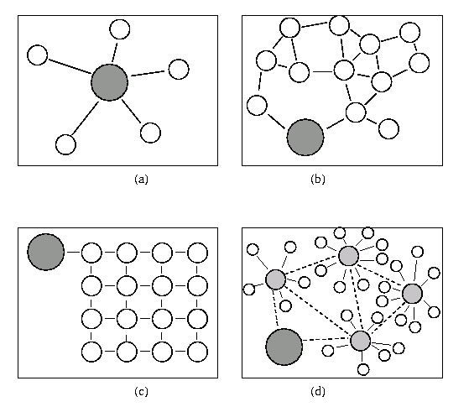
Network topologies
(a) a star-connected single-hop topology,
(b) flat multi-hop mesh, (c) structured grid, and (d) two-tier hierarchical cluster topology

Slide 21
Two-tier hierarchical cluster:
Perhaps the most compelling architecture for WSN is a deployment architecture where multiple nodes within each local region report to different cluster heads .
There are a number of ways in which such a hierarchical architecture may be implemented .
This approach becomes particularly attractive in heterogeneous settings when the cluster-head nodes are more powerful in terms of computation/communication.
The advantage of the hierarchical cluster based approach is that it naturally decomposes a large network into separate zones within which data processing and aggregation can be performed locally. Within each cluster there could be either single-hop or multi-hop communication.
Once data reach a cluster-head they would then be routed through the second tier network formed by cluster-heads to another cluster-head or a gateway. The second-tier network may utilize a higher bandwidth radio or it could even be a wired network if the second-tier nodes can all be connected to the wired infrastructure.
Having a wired network for the second tier is relatively easy in building-like environments, but not for random deployments in remote locations. In random deployments there may be no designated cluster-heads; these may have to be determined by some process of self-election.

Slide 22
Connectivity in geometric random graphs:
The connectivity (and coverage) properties of random deployments can be best analyzed using Random Graph Theory. There are several models of random graphs that have been studied in the literature
A random graph model is essentially a systematic description of some random experiment that can be used to generate graph instances. These models usually contain a tuning parameter that varies the average density of the constructed random graph. The Bernoulli random graphs G(n,p) studied in traditional Random Graph Theory, are formed by taking n vertices and placing random edges between each pair of vertices independently with probability p.
A random graph model that more closely represents wireless multi-hop networks is the geometric random graph G(n,R). In a G(n,R) geometric random graph, n nodes are placed at random with uniform distribution in a square area of unit size (more generally, a d-dimensional cube). There is an edge u v between any pair of nodes u and v, if the Euclidean distance between them is less than R.

Slide 23
Fig explains below G(n, R) for n=40 at two different R values. When R is small, each node can connect only to other nodes that are close by, and the resulting graph is sparse; on the other hand, a large R allows longer links and results in a dense connectivity.
Compared with Bernoulli random graphs, G(n, R) geometric random graphs need different analytical techniques. This is because geometric random graphs do not show independence between edges. For instance, the probability that edge (u, v) exists is not independent of the probability that edge u w and edge (v, w) exist.

Slide 24
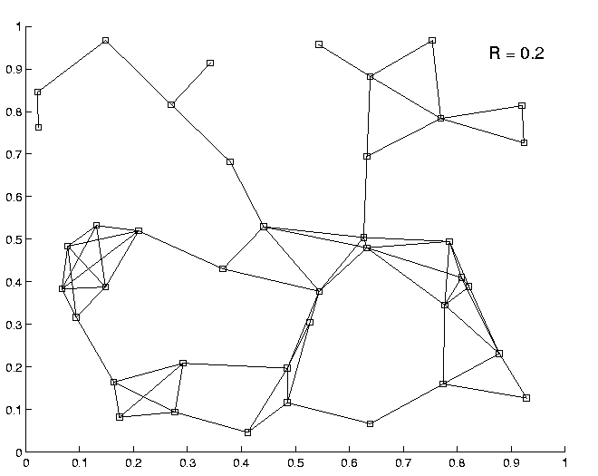
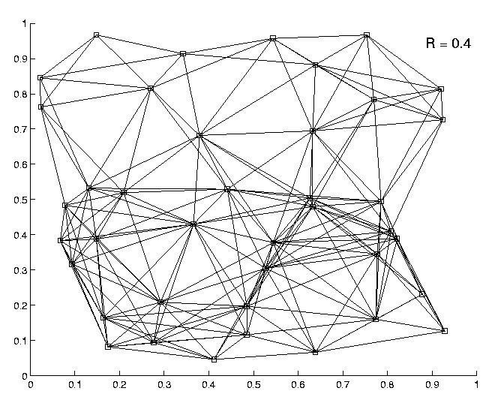
Geometric Random Graph G(n,R)

Slide 25
Connectivity in G(n, R):
Figure below (a) shows how the probability of network connectivity varies as the radius parameter R of a geometric random graph is varied. Depending on the number of nodes n, there exist different critical radii beyond which the graph is connected with high probability. These transitions become sharper (shifting to lower radii) as the number of nodes increases.
Figure below (b) shows the probability that the network is connected with respect to the total number of nodes for different values of fixed transmission range in a fixed area for all nodes. It can be observed that, depending on the transmission range, there is some number of nodes beyond which there is a high probability that the network obtained is connected. This kind of analysis is relevant for random network deployment, as it provides insights into the minimum density that may be needed to ensure that the network is connected.

Slide 26
In other words, the critical transmission range for connectivity is
O(√(log n/n))
Another surprising result is that the critical radius at which a geometric random graph G(n,R) attains the property that all nodes have at least K neighbors is asymptotically equal to the critical radius at which the graph attains the property of K-connectivity.

Slide 27
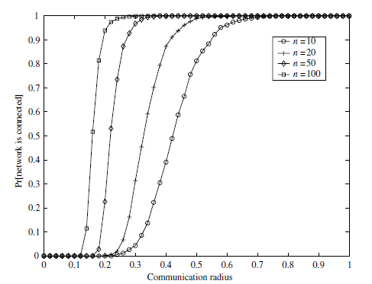
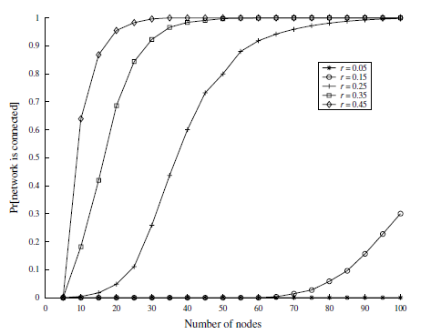

Slide 28
Monotone properties in G(n, R) :
A monotonically increasing property is any graph property that continues to hold if additional edges are added to a graph that already has the property. A graph property is called monotone if the property or its inverse are monotonically increasing. Nearly all graph properties of interest from a networking perspective, such as K-connectivity, Hamilton city, K-colorability, etc., are monotone. A key theoretical result pertaining to G(n,R) geometric random graphs is that all monotone properties show critical phase transitions . Further, all monotone properties are satisfied with high probability within a critical transmission range.
O(√(log n/n) log ¼ n)
Connectivity in G(n, K) :
Another geometric random graph model is G(n,K)where n nodes are placed at random in a unit area, and each node connects to its K nearest neighbors. This model potentially allows different nodes in the network to use different powers.
K must be higher than 0074 log n and lower than 272 log n, in order to ensure asymptotically almost sure connectivity

Slide 29
Connectivity and coverage in G grid(n, p, R):
Yet another geometric random graph model is the unreliable sensor grid model. In this model n nodes are placed on a square grid within a unit area, p is the probability that a node is active (not failed), and R is the transmission range of each node. For this unreliable sensor grid model, the following properties have been determined:
• For the active nodes to form a connected topology, as well as to cover the unit square region, p ・R2 must be
O(√(log n/n))
• The maximum number of hops required to travel from any active node to another
O(√(n/ log n))
There exists a range of p values sufficiently small such that the active nodes form a connected topology but do not cover the unit square

Slide 30
3.Connectivity using power control
This parameter is the radio transmission power setting for all nodes in the network.
Power control is quite a complex and challenging cross-layer issue. Increasing radio transmission power has a number of interrelated consequences – some of these are positive, others negative:
• It can extend the communication range, increasing the number of communicating neighboring nodes and improving connectivity in the form of availability of end-to-end paths.
• For existing neighbors, it can improve link quality (in the absence of other interfering traffic).
• It can induce additional interference that reduces capacity and introduces congestion.
• It can cause an increase in the energy expended.

